Slide 1

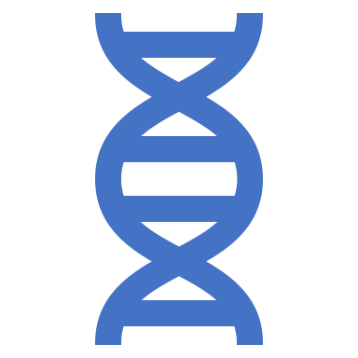
Research questions
What are the interesting mutations?
What are the clusters that exist among the mutations?
What are the clusters that exist among the samples?
What is the biological significance of the data?

Slide 2
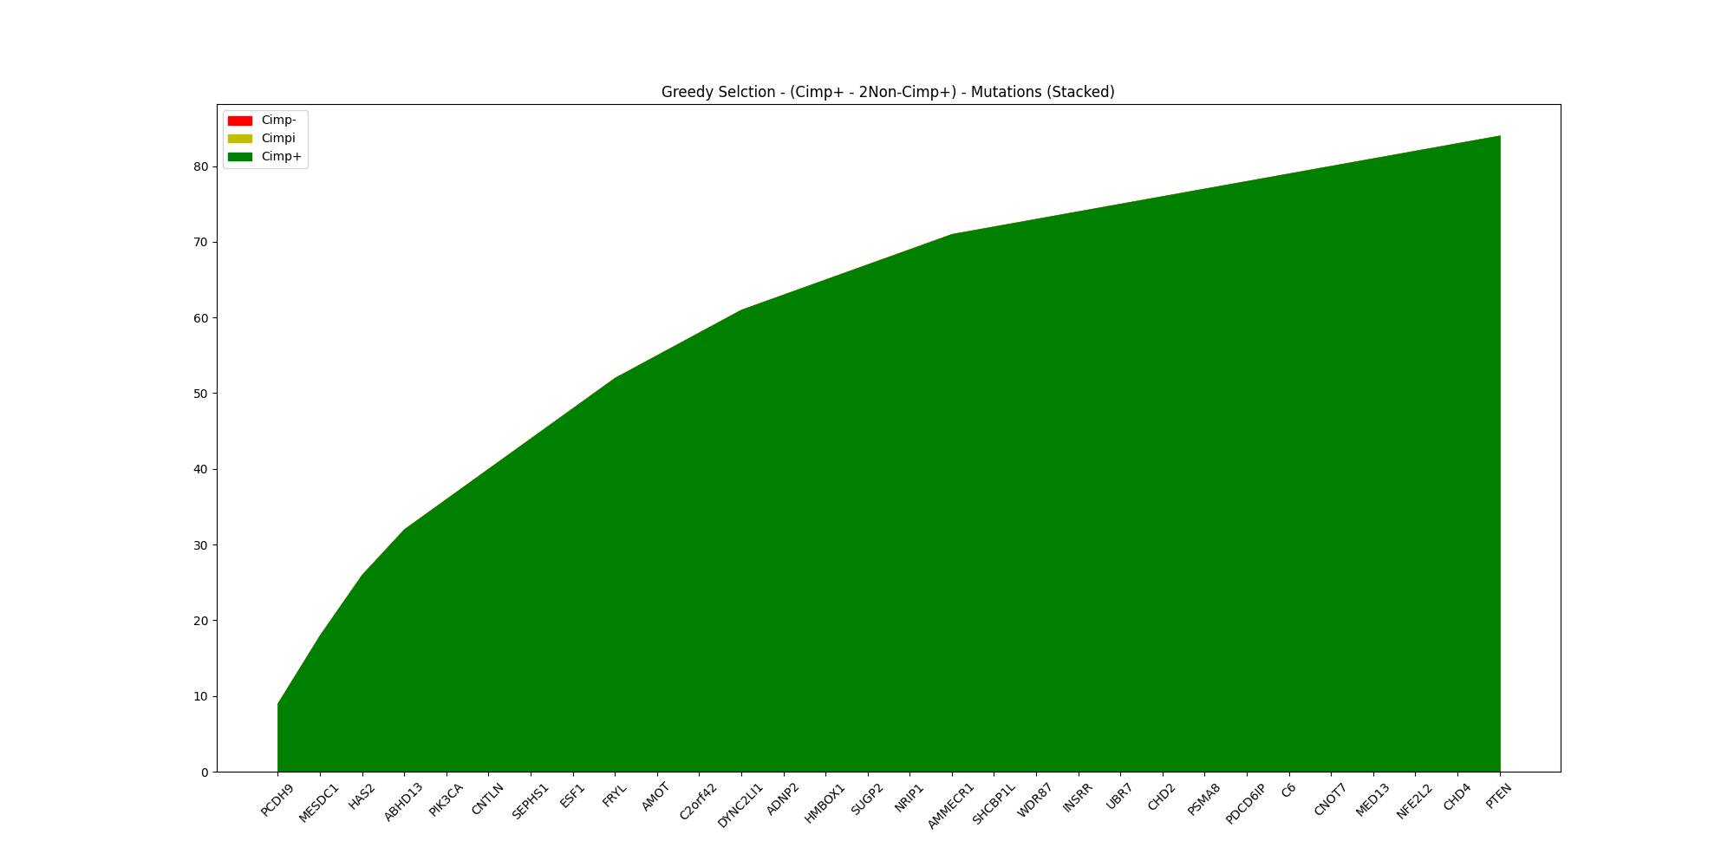
Summary of Results
Greedy algorithm found 34 motifs that cover
84 CIMP+ samples
0 CIMPi samples
0 CIMP- samples
Motif ranking function:
CIMP+ - 2*Non-CIMP+

Slide 3
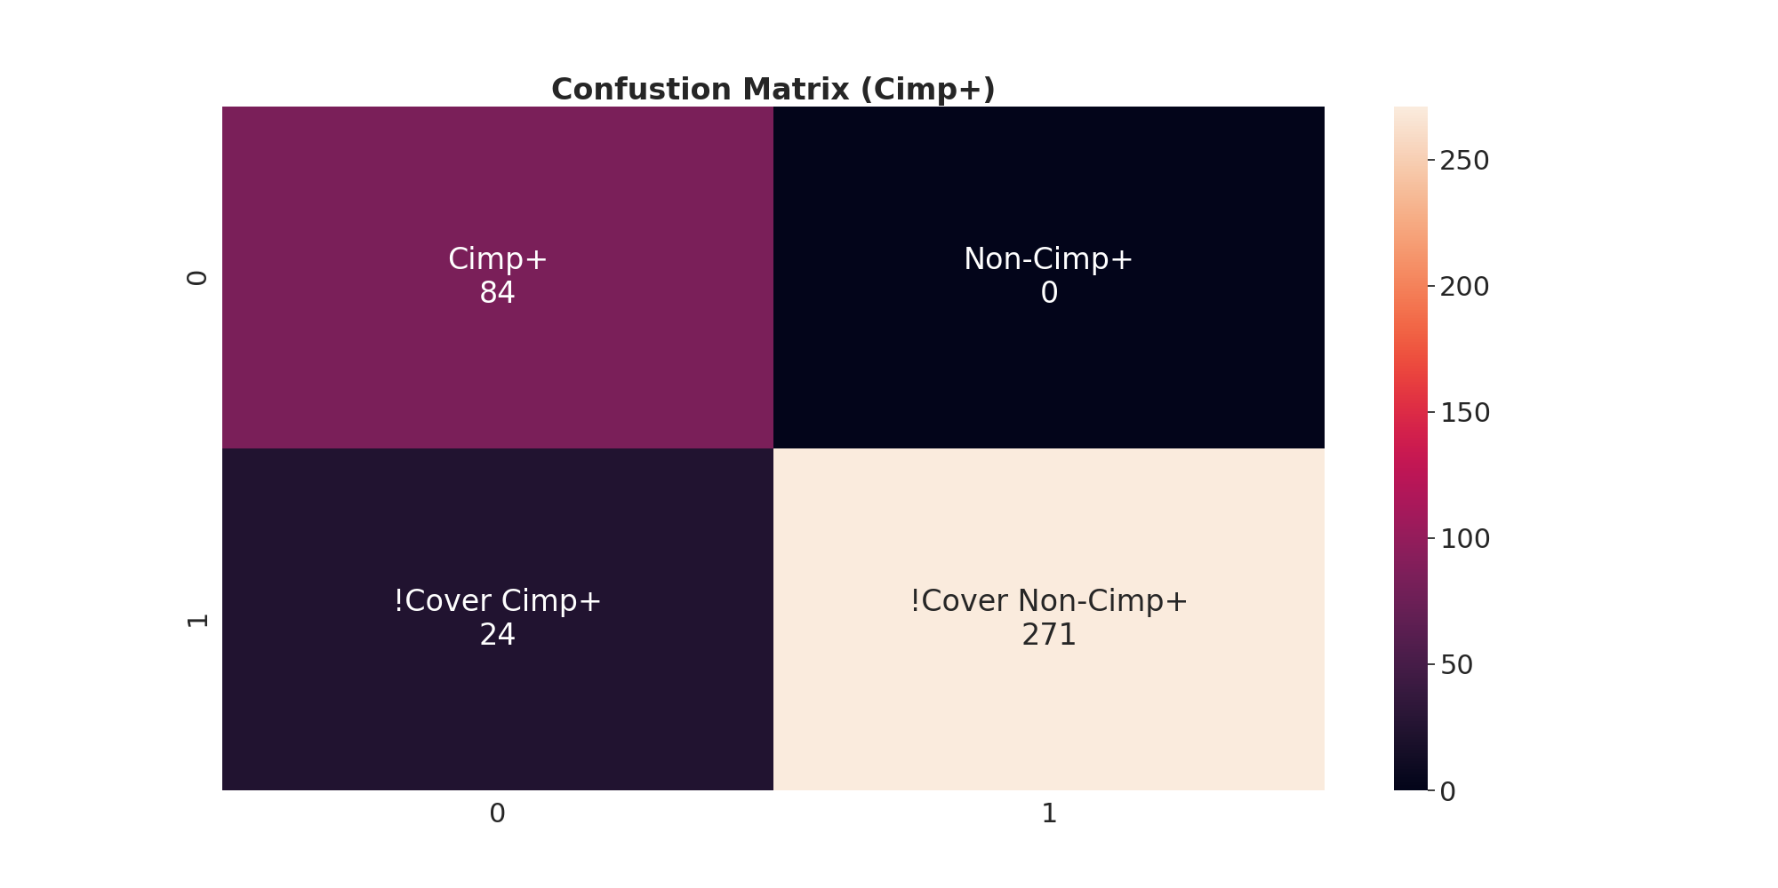
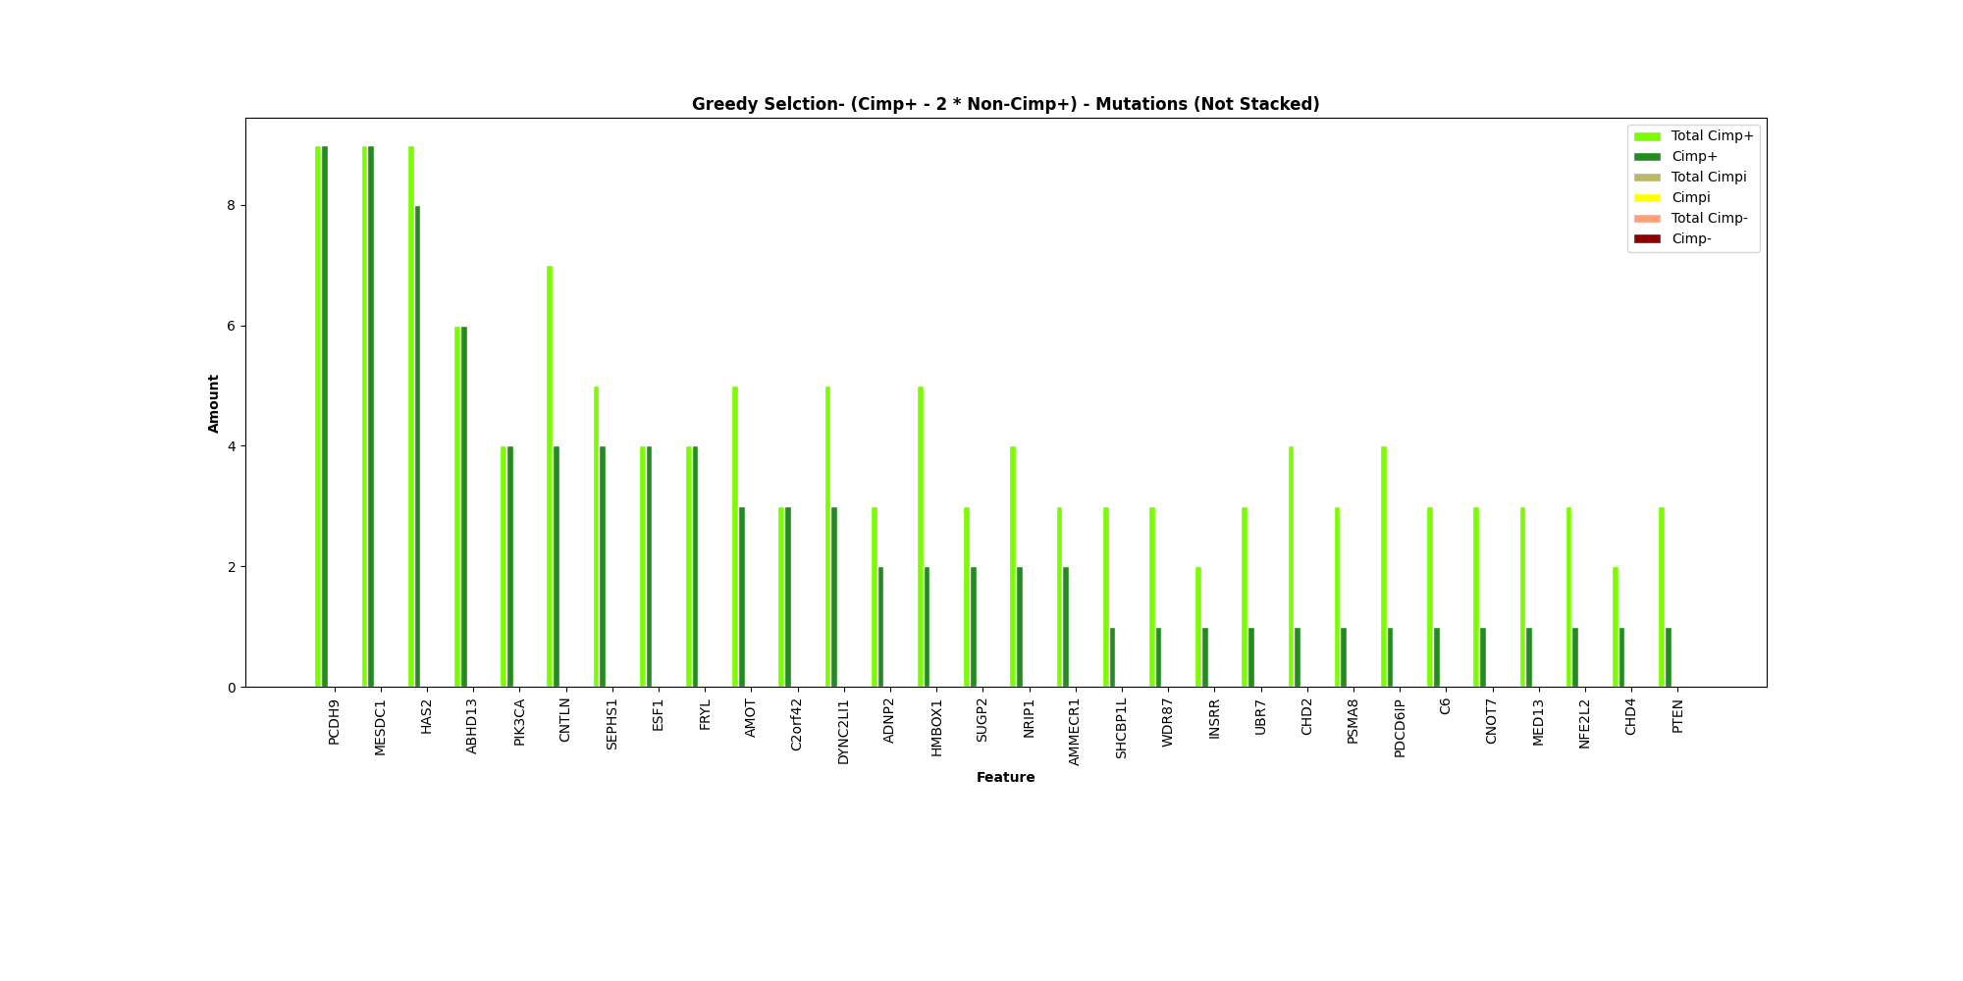
Select by Cimp+ - 2Non-Cimp+

Slide 4
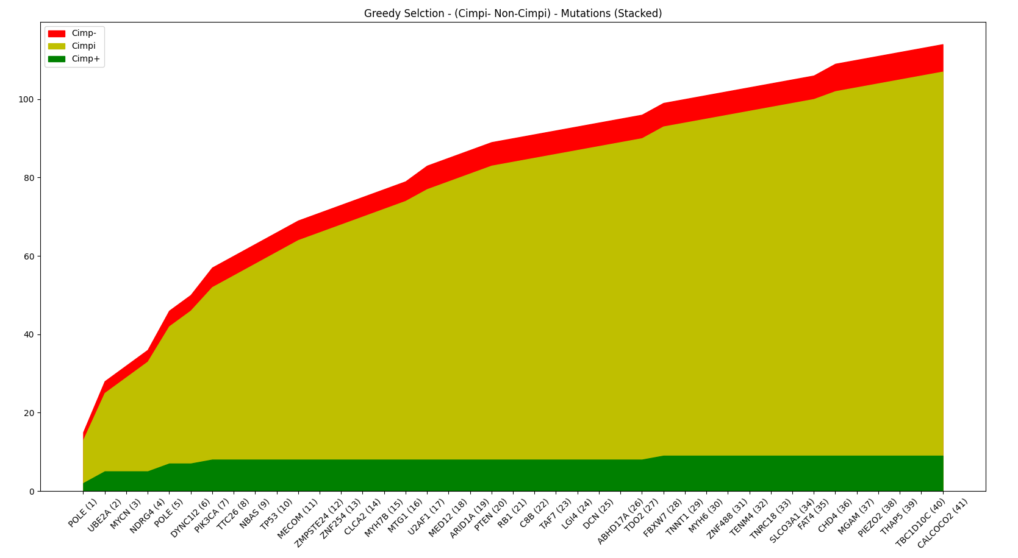
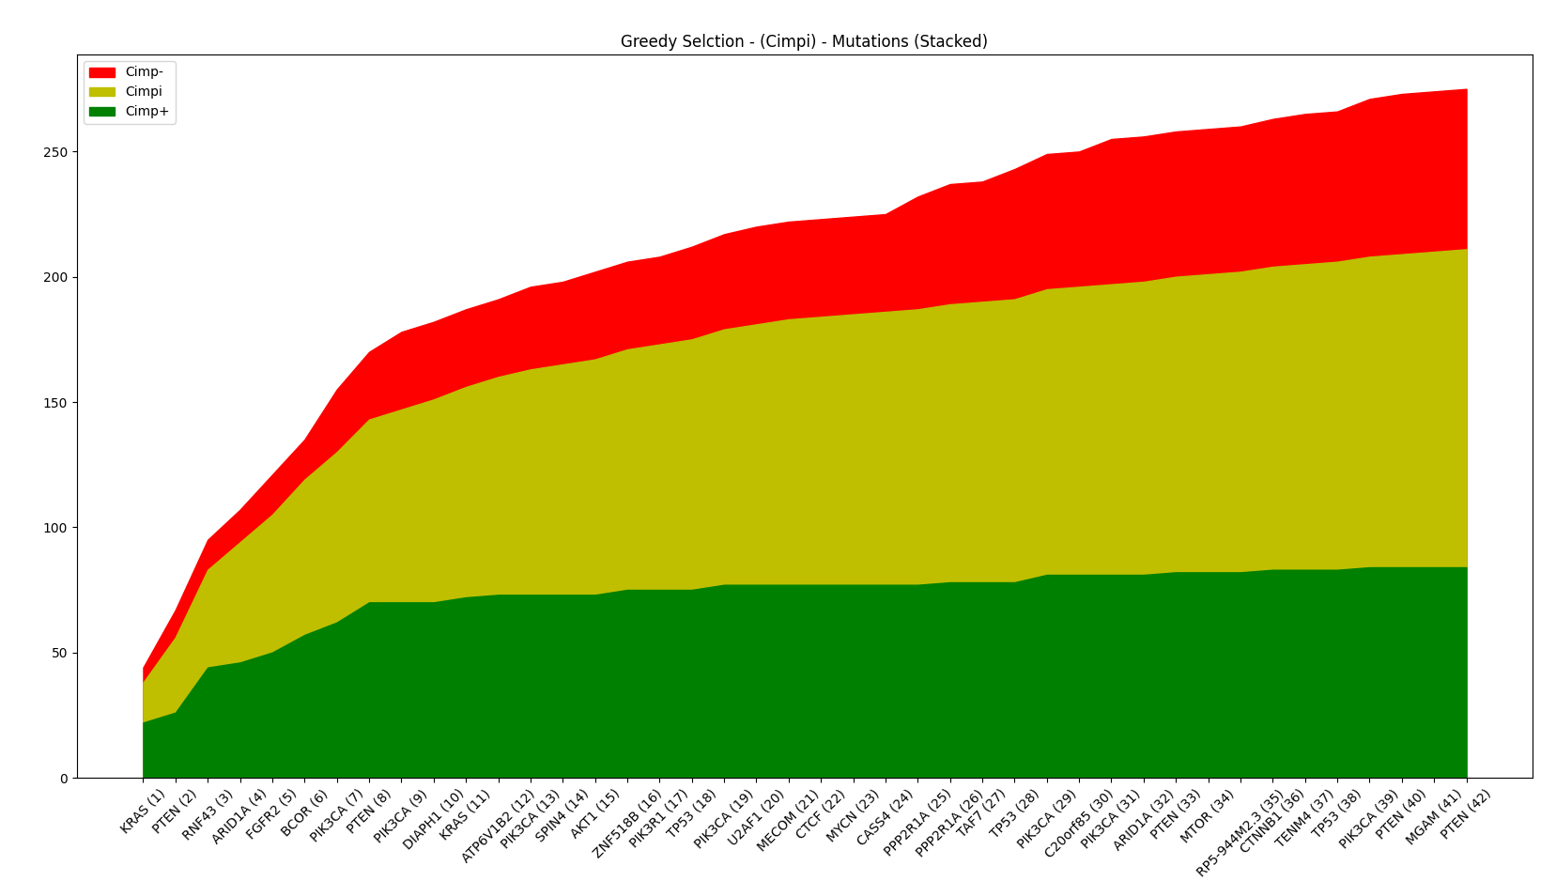
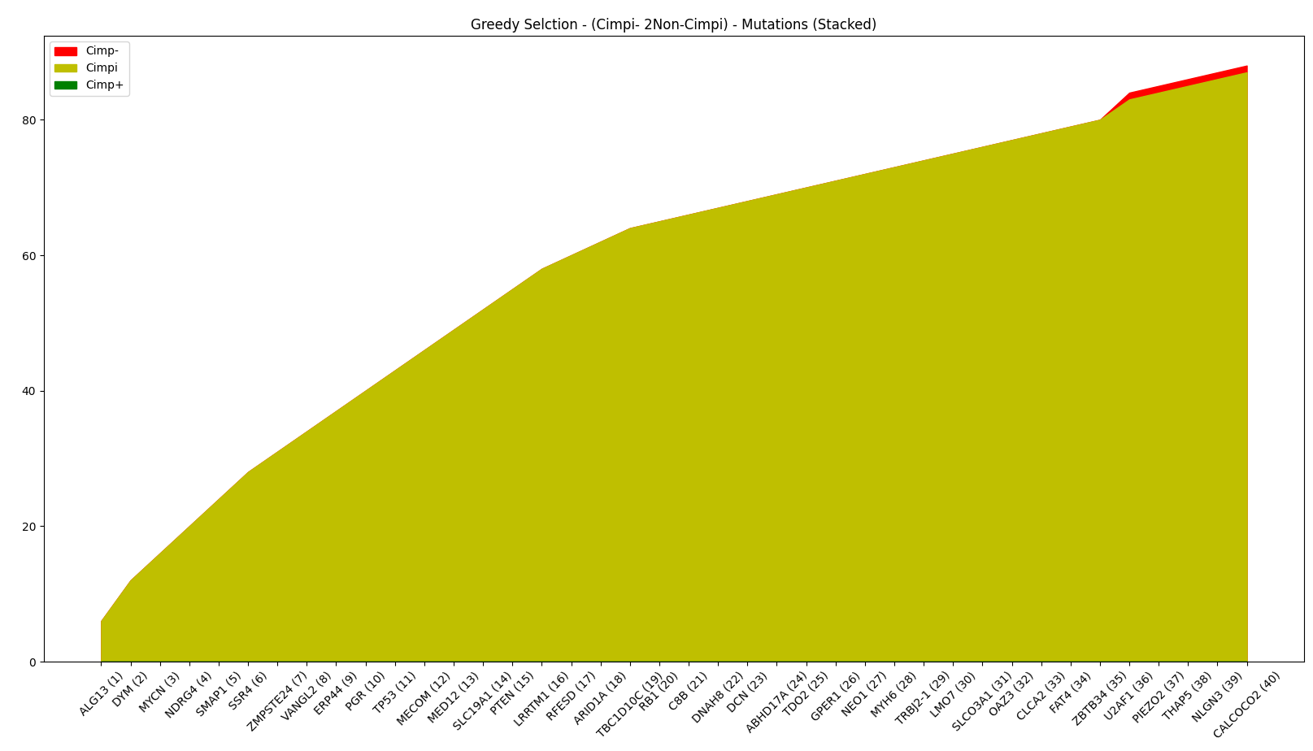
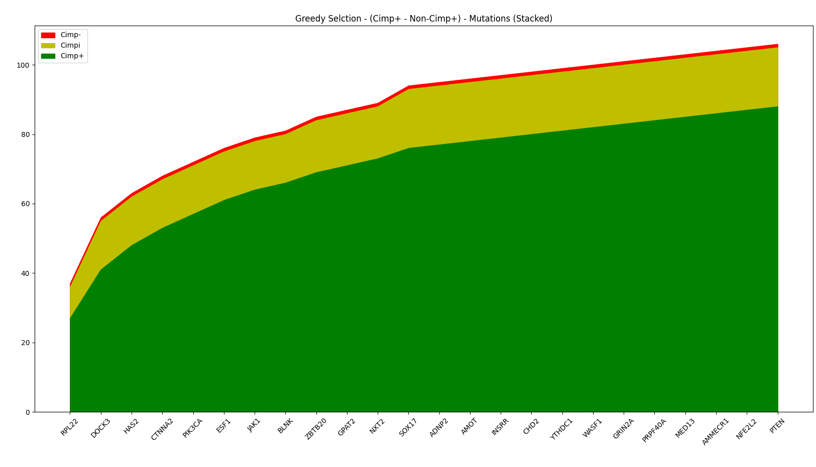

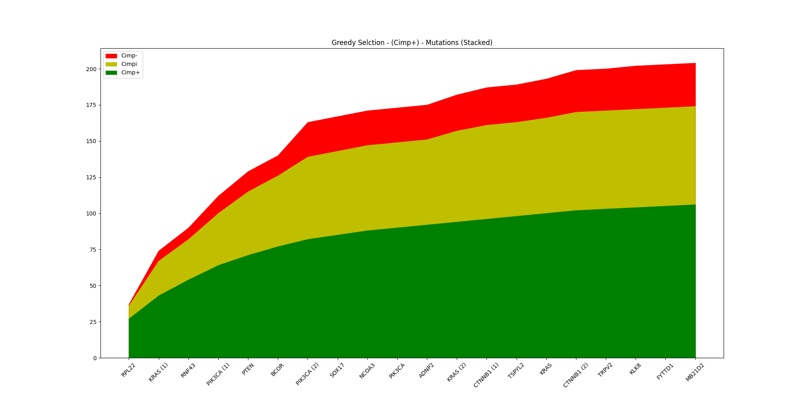

Slide 5

Gene Level Graphs
Examples:
GOT1
RPL22
KRAS

Slide 6

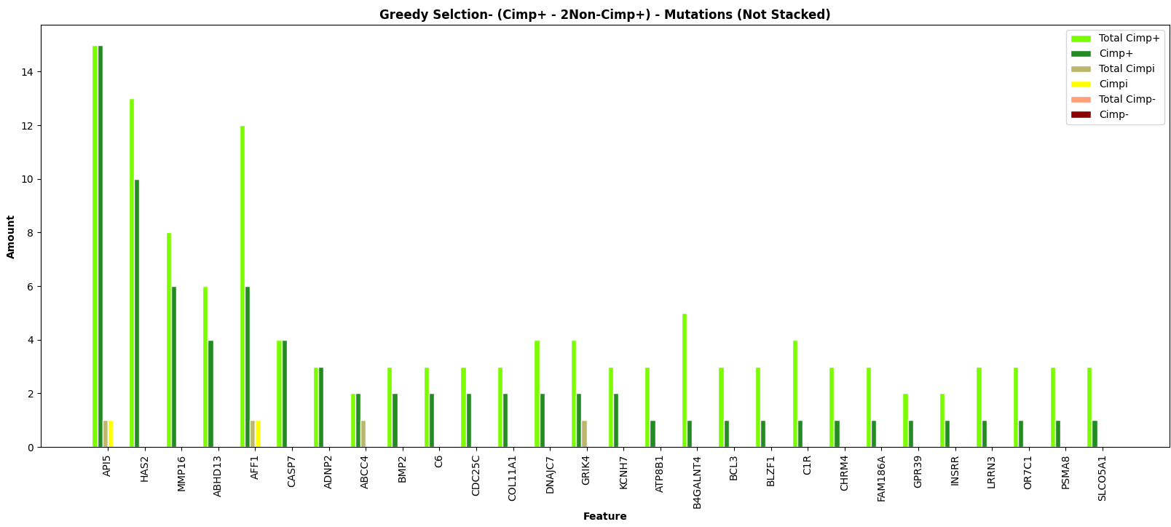
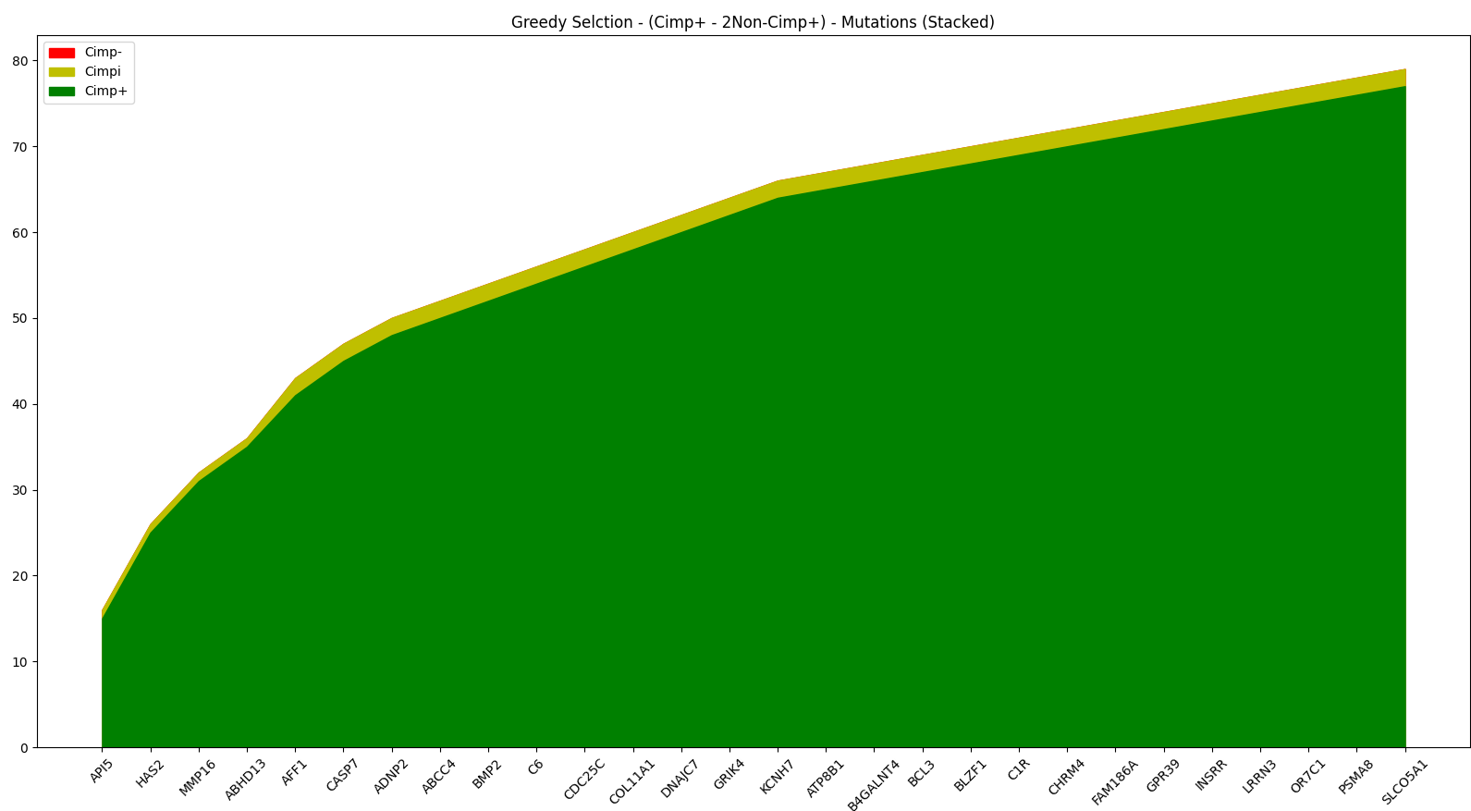
Select by Cimp+ - 2Non-Cimp+

Slide 7
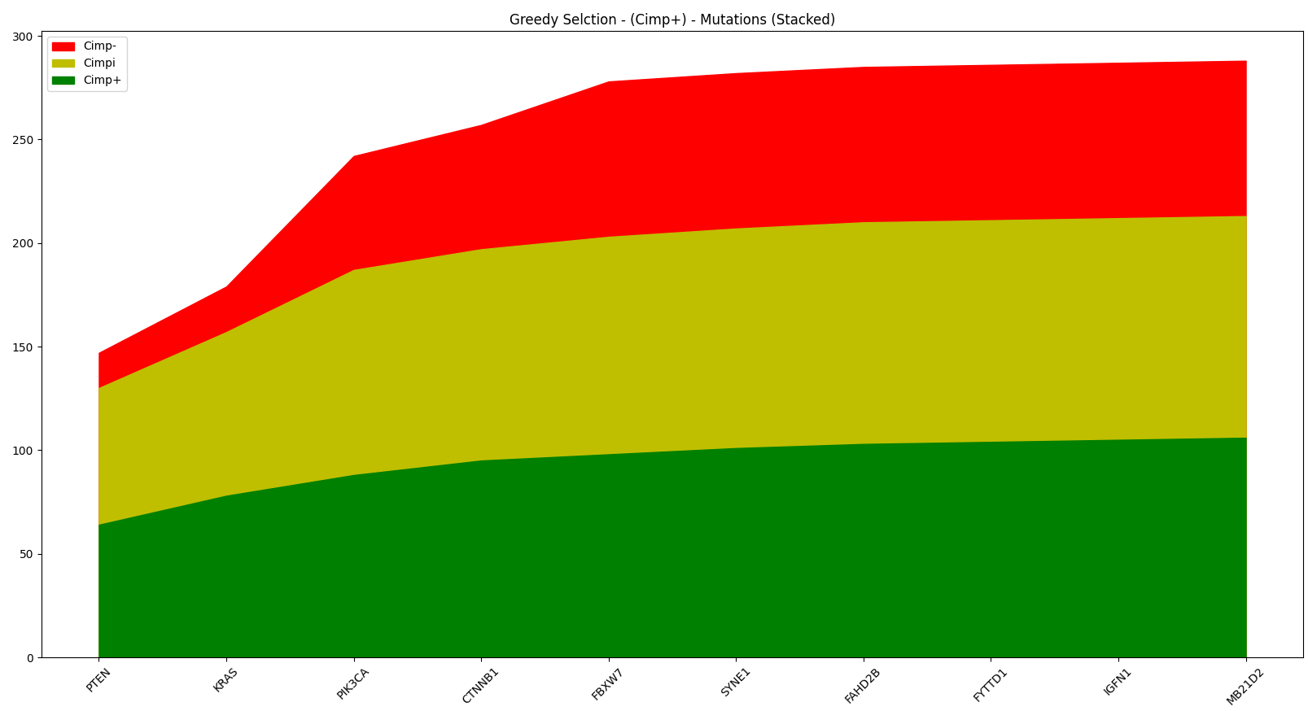

Slide 8
ClusterGrammer with MSI
Top 75 mutations in Cimp+
https://maayanlab.cloud/clustergrammer/viz_sim_mats/5f6a216f51ad21000f2ef54c/75_cimppos.txt
Top 75 mutations in Non-Cimp+
https://maayanlab.cloud/clustergrammer/viz_sim_mats/5f6a219951ad21000f2ef553/75_noncimp.txt
Top 75 mutations in 300 Cimp+
https://maayanlab.cloud/clustergrammer/viz_sim_mats/5f6a21c851ad21000f2ef55a/300_cimppos.txt

Slide 9
ClusterGrammer Results
Set of 75 mutations cimp+:
https://maayanlab.cloud/clustergrammer/viz_sim_mats/5f5be30251ad21000f37b477/75_cimppos.txt
The 300 mutations cimp+:
https://maayanlab.cloud/clustergrammer/viz_sim_mats/5f5bfd0651ad21000f37b50f/300_cimppos.txt
The small set of mutations selected by your greedy algorithm:
https://maayanlab.cloud/clustergrammer/viz_sim_mats/5f5c0ddb51ad21000f37b553/25_TP_FP.txt
Relevant mutations for non-cimp+ (FP > 8):
https://maayanlab.cloud/clustergrammer/viz_sim_mats/5f5bfd4151ad21000f37b516/top_noncimp_9_or_more.txt
on-cimp+ and the 75 most relevant mutations for cimp+:
https://maayanlab.cloud/clustergrammer/viz_sim_mats/5f5bfd6651ad21000f37b51d/75_noncimp.txt

Slide 10
SUPPLEMENTARY MATERIALS

Slide 11

Mutation level graphs

Slide 12
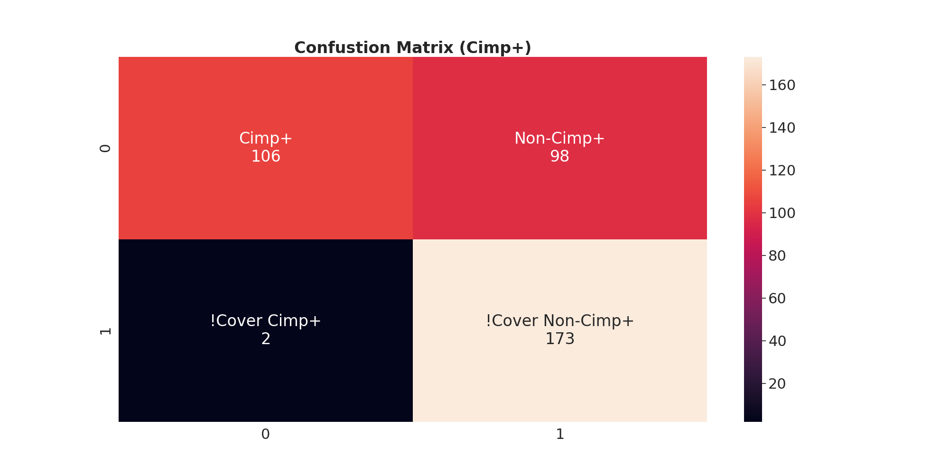
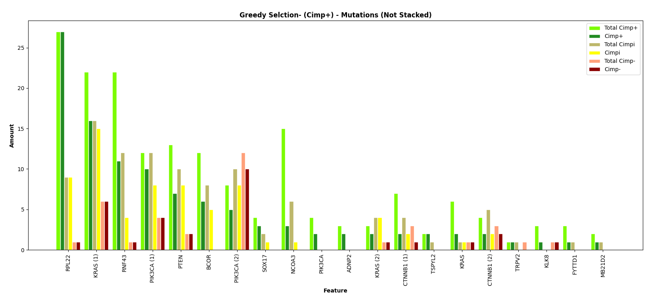
Select by Cimp+

Slide 13
Name | Cimp+ | Non-Cimp+
RPL22 | 27 | 10
KRAS | 16 | 21
RNF43 | 11 | 5
PIK3CA | 10 | 12
PTEN | 7 | 10
BCOR | 6 | 5
PIK3CA | 5 | 18
SOX17 | 3 | 1
NCOA3 | 3 | 1
PIK3CA | 2 | 0
ADNP2 | 2 | 0
KRAS | 2 | 5
CTNNB1 | 2 | 3
TSPYL2 | 2 | 0
Name | Cimp+ | Non-Cimp+
KRAS | 2 | 2
CTNNB1 | 2 | 4
TRPV2 | 1 | 0
KLK8 | 1 | 1
FYTTD1 | 1 | 0
MB21D2 | 1 | 0
Metric | Value
TP | 106
FP | 98
FN | 2
TN | 173
Accuracy | 0.736
Sensitivity | 0.981
Specificity | 0.638
Precision | 0.52
Miss Rate | 0.019
False Discovery Rate | 0.48
False Omission Rate | 0.011

Slide 14

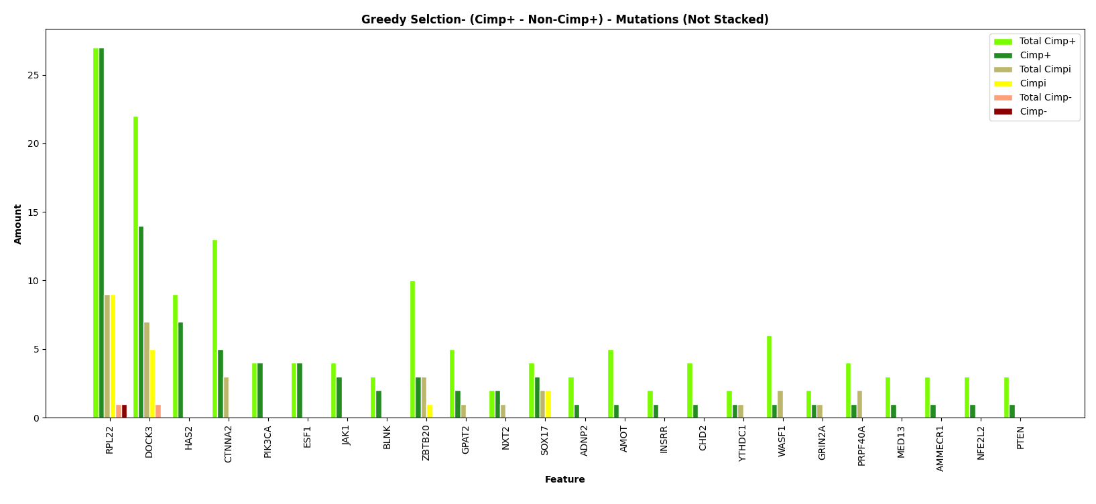
Select by Cimp+ - Non-Cimp+

Slide 15
Name | Cimp+ | Non-Cimp+
RPL22 | 27 | 10
DOCK3 | 14 | 5
HAS2 | 7 | 0
CTNNA2 | 5 | 0
PIK3CA | 4 | 0
ESF1 | 4 | 0
JAK1 | 3 | 0
BLNK | 2 | 0
ZBTB20 | 3 | 1
GPAT2 | 2 | 0
NXT2 | 2 | 0
SOX17 | 3 | 2
ADNP2 | 1 | 0
AMOT | 1 | 0
Name | Cimp+ | Non-Cimp+
INSRR | 1 | 0
CHD2 | 1 | 0
YTHDC1 | 1 | 0
WASF1 | 1 | 0
GRIN2A | 1 | 0
PRPF40A | 1 | 0
MED13 | 1 | 0
AMMECR1 | 1 | 0
NFE2L2 | 1 | 0
PTEN | 1 | 0
Metric | Value
TP | 88
FP | 18
FN | 20
TN | 253
Accuracy | 0.9
Sensitivity | 0.815
Specificity | 0.934
Precision | 0.83
Miss Rate | 0.185
False Discovery Rate | 0.17
False Omission Rate | 0.073

Slide 16
Select by Cimp+ - 2Non-Cimp+

Slide 17
Name | Cimp+ | Non-Cimp+
PCDH9 | 9 | 0
MESDC1 | 9 | 0
HAS2 | 8 | 0
ABHD13 | 6 | 0
PIK3CA | 4 | 0
CNTLN | 4 | 0
SEPHS1 | 4 | 0
ESF1 | 4 | 0
FRYL | 4 | 0
AMOT | 3 | 0
C2orf42 | 3 | 0
DYNC2LI1 | 3 | 0
ADNP2 | 2 | 0
HMBOX1 | 2 | 0
Name | Cimp+ | Non-Cimp+
SUGP2 | 2 | 0
NRIP1 | 2 | 0
AMMECR1 | 2 | 0
SHCBP1L | 1 | 0
WDR87 | 1 | 0
INSRR | 1 | 0
UBR7 | 1 | 0
CHD2 | 1 | 0
PSMA8 | 1 | 0
PDCD6IP | 1 | 0
C6 | 1 | 0
CNOT7 | 1 | 0
MED13 | 1 | 0
(3) | 1 | 0
Metric | Value
TP | 84
FP | 0
FN | 24
TN | 271
Accuracy | 0.937
Sensitivity | 0.778
Specificity | 1
Precision | 1
Miss Rate | 0.222
False Discovery Rate | 0
False Omission Rate | 0.081

Slide 18

Select by Cimp+ - 2Cimp- - Cimpi

Slide 19
Name | Cimp+ | Non-Cimp+
RPL22 | 27 | 10
DOCK3 | 14 | 5
HAS2 | 7 | 0
CTNNA2 | 5 | 0
PIK3CA | 4 | 0
ESF1 | 4 | 0
JAK1 | 3 | 0
BLNK | 2 | 0
ZBTB20 | 3 | 1
GPAT2 | 2 | 0
NXT2 | 2 | 0
SOX17 | 3 | 2
ADNP2 | 1 | 0
AMOT | 1 | 0
Name | Cimp+ | Non-Cimp+
INSRR | 1 | 0
CHD2 | 1 | 0
YTHDC1 | 1 | 0
WASF1 | 1 | 0
GRIN2A | 1 | 0
PRPF40A | 1 | 0
MED13 | 1 | 0
AMMECR1 | 1 | 0
NFE2L2 | 1 | 0
PTEN | 1 | 0
Metric | Value
TP | 88
FP | 18
FN | 20
TN | 253
Accuracy | 0.942
Sensitivity | 0.815
Specificity | 0.996
Precision | 0.989
Miss Rate | 0.185
False Discovery Rate | 0.011
False Omission Rate | 0.073

Slide 20
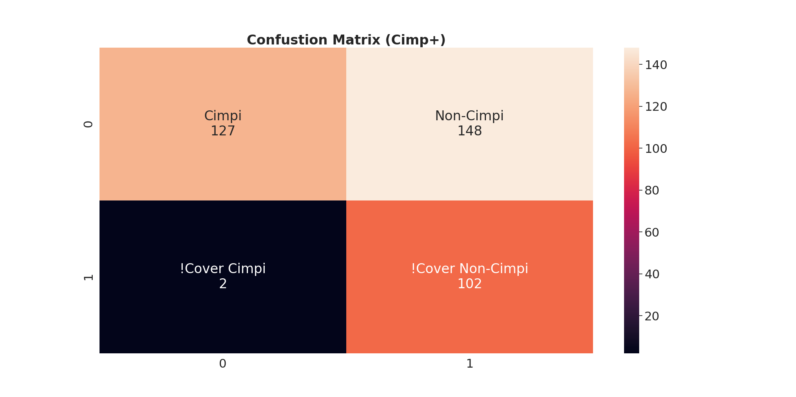
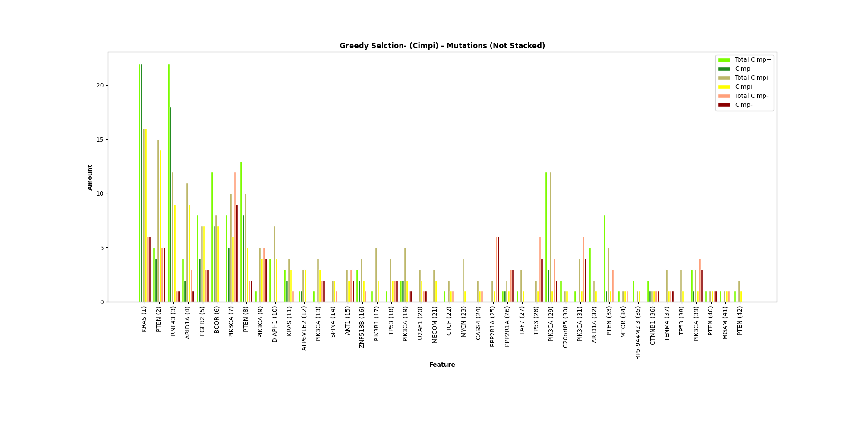
Select by Cimpi

Slide 21
Name | Cimpi | Non-Cimpi
KRAS | 16 | 28
PTEN | 14 | 9
RNF43 | 9 | 19
ARID1A | 9 | 3
FGFR2 | 7 | 7
BCOR | 7 | 7
PIK3CA | 6 | 14
PTEN | 5 | 10
PIK3CA | 4 | 4
DIAPH1 | 4 | 0
KRAS | 3 | 2
ATP6V1B2 | 3 | 1
PIK3CA | 3 | 2
SPIN4 | 2 | 0
Name | Cimpi | Non-Cimpi
AKT1 | 2 | 2
ZNF518B | 2 | 2
PIK3R1 | 2 | 0
TP53 | 2 | 2
PIK3CA | 2 | 3
U2AF1 | 2 | 1
MECOM | 2 | 0
CTCF | 1 | 0
MYCN | 1 | 0
CASS4 | 1 | 0
PPP2R1A | 1 | 6
PPP2R1A | 1 | 4
TAF7 | 1 | 0
(15) | 15 | 22
Metric | Value
TP | 127
FP | 148
FN | 2
TN | 102
Accuracy | 0.604
Sensitivity | 0.984
Specificity | 0.408
Precision | 0.462
Miss Rate | 0.016
False Discovery Rate | 0.538
False Omission Rate | 0.019

Slide 22
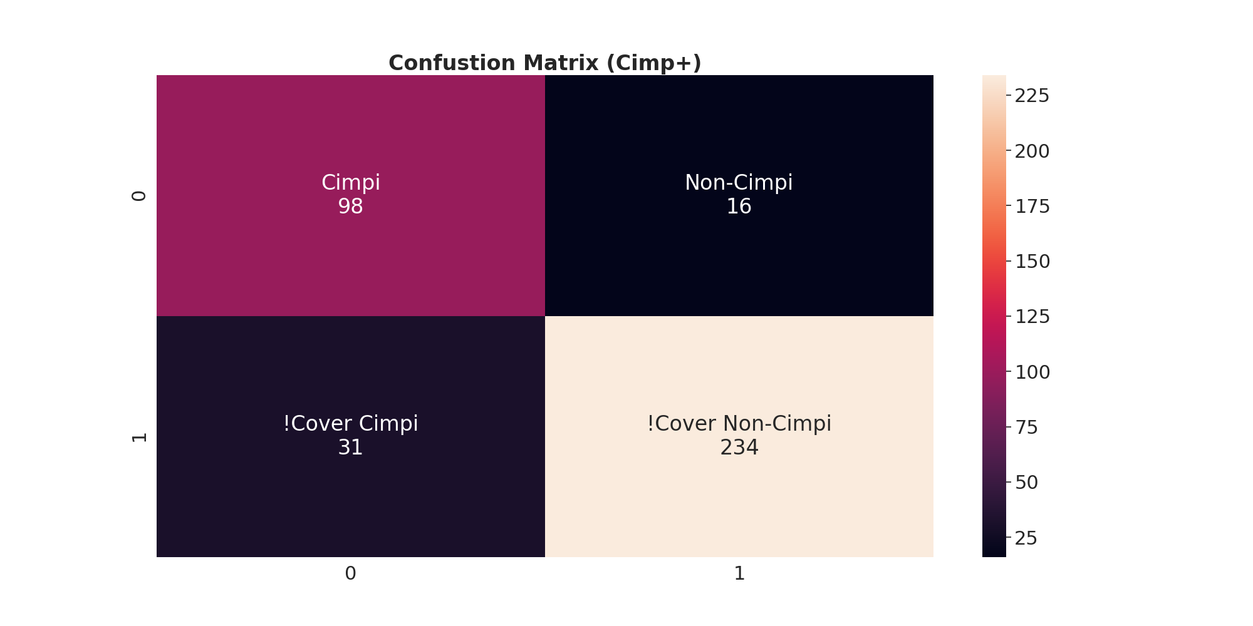
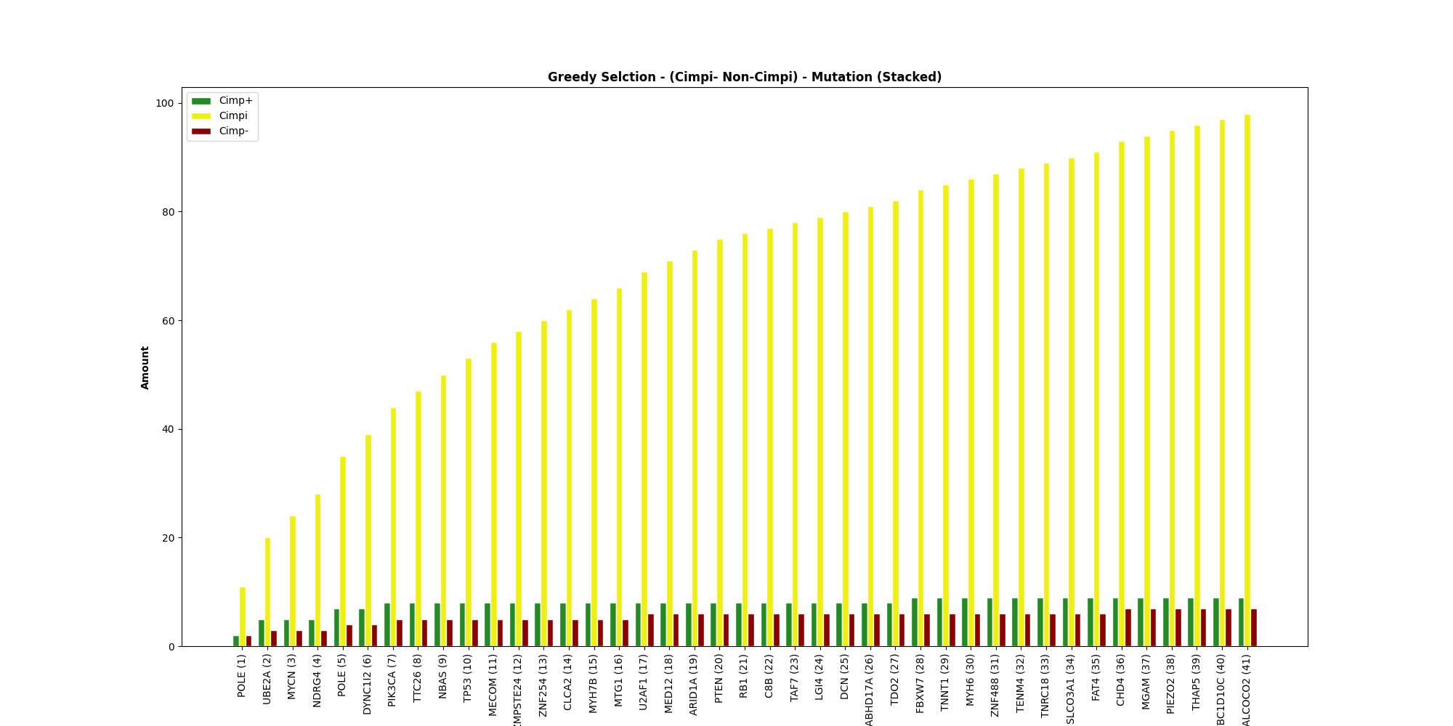
Select by Cimpi – Non-Cimpi

Slide 23
Name | Cimpi | Non-Cimpi
POLE | 11 | 4
UBE2A | 9 | 4
MYCN | 4 | 0
NDRG4 | 4 | 0
POLE | 7 | 3
DYNC1I2 | 4 | 0
PIK3CA | 5 | 2
TTC26 | 3 | 0
NBAS | 3 | 0
TP53 | 3 | 0
MECOM | 3 | 0
ZMPSTE24 | 2 | 0
ZNF254 | 2 | 0
CLCA2 | 2 | 0
Name | Cimpi | Non-Cimpi
MYH7B | 2 | 0
MTG1 | 2 | 0
U2AF1 | 3 | 1
MED12 | 2 | 0
ARID1A | 2 | 0
PTEN | 2 | 0
RB1 | 1 | 0
C8B | 1 | 0
TAF7 | 1 | 0
LG14 | 1 | 0
DCN | 1 | 0
ABHD17A | 1 | 0
TDO2 | 1 | 0
(14) | 16 | 2
Metric | Value
TP | 98
FP | 16
FN | 31
TN | 234
Accuracy | 0.876
Sensitivity | 0.76
Specificity | 0.936
Precision | 0.86
Miss Rate | 0.24
False Discovery Rate | 0.14
False Omission Rate | 0.117

Slide 24

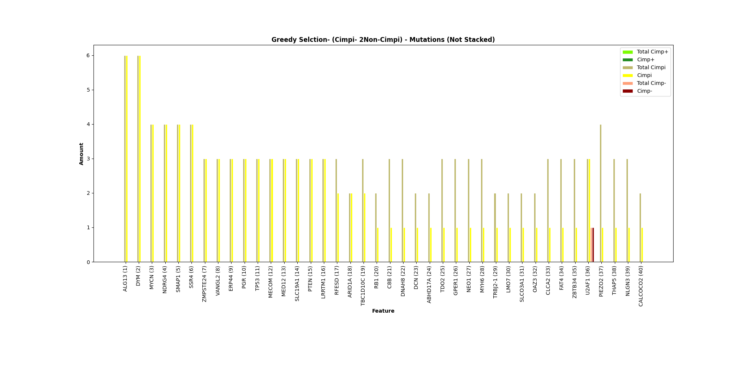
Select by Cimpi – 2Non-Cimpi

Slide 25
Name | Cimpi | Non-Cimpi
ALG13 | 6 | 0
DYM | 6 | 0
MYCN | 4 | 0
NDRG4 | 4 | 0
SMAP1 | 4 | 0
SSR4 | 4 | 0
ZMPSTE24 | 3 | 0
VANGL2 | 3 | 0
ERP44 | 3 | 0
PGR | 3 | 0
TP53 | 3 | 0
MECOM | 3 | 0
MED12 | 3 | 0
SLC19A1 | 3 | 0
Name | Cimpi | Non-Cimpi
PTEN | 3 | 0
LRRTM1 | 3 | 0
RFESD | 2 | 0
ARID1A | 2 | 0
TBC1D10C | 2 | 0
RB1 | 1 | 0
C8B | 1 | 0
DNAH8 | 1 | 0
DCN | 1 | 0
ABHD17A | 1 | 0
TDO2 | 1 | 0
GPER1 | 1 | 0
U2AF1 | 3 | 1
(13) | 13 | 0
Metric | Value
TP | 87
FP | 1
FN | 42
TN | 249
Accuracy | 0.887
Sensitivity | 0.674
Specificity | 0.996
Precision | 0.989
Miss Rate | 0.326
False Discovery Rate | 0.011
False Omission Rate | 0.144

Slide 26
Gene Level Graphs

Slide 27
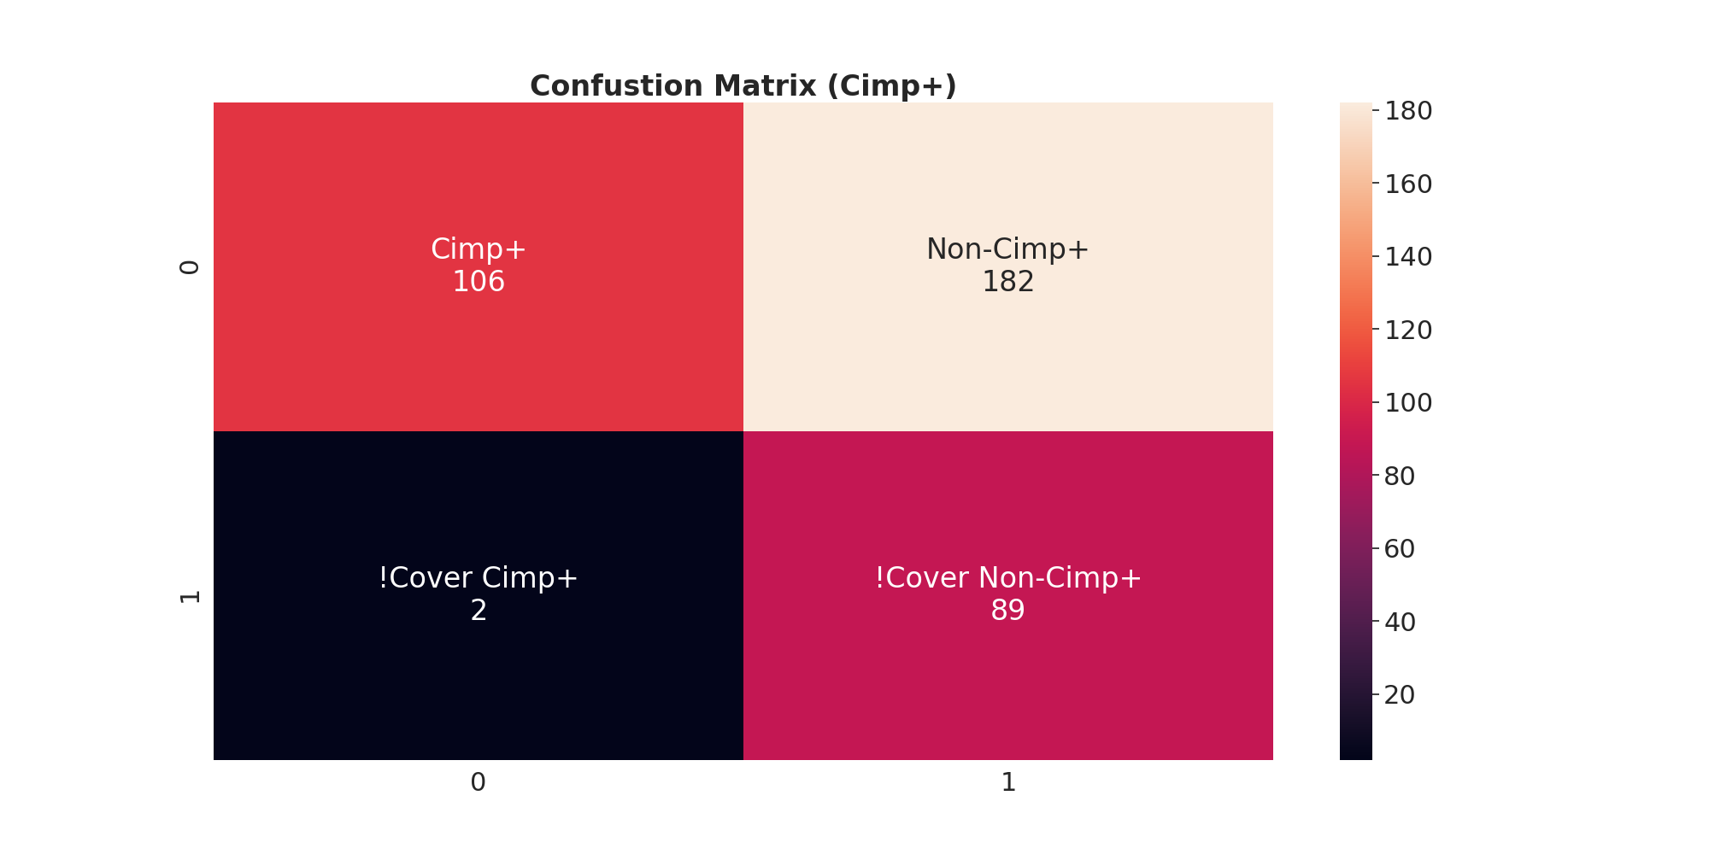
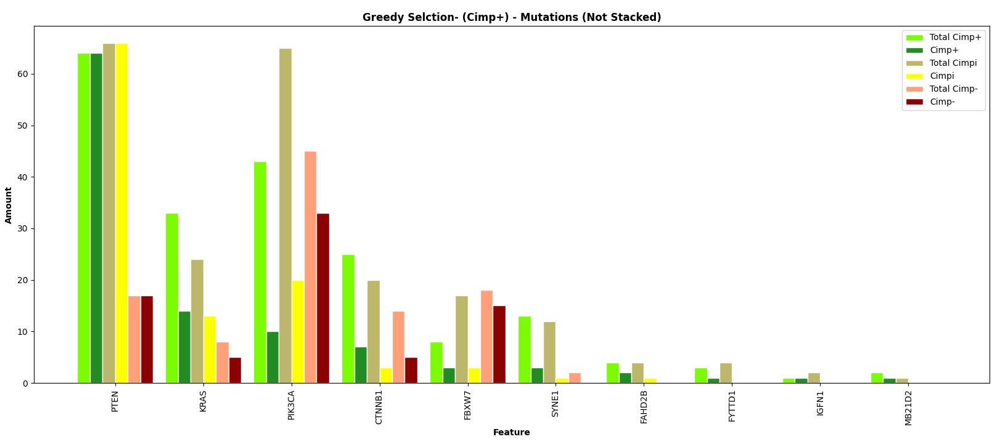
Select by Cimp+

Slide 28
Name | Cimp+ | Non-Cimp+
PTEN | 64 | 83
KRAS | 14 | 18
PIK3CA | 10 | 53
CTNNB1 | 7 | 8
FNXW7 | 3 | 18
SYNE1 | 3 | 1
FAHD2B | 2 | 1
FYTTDI | 1 | 0
IGFN1 | 1 | 0
MB21D2 | 1 | 0
Name | Cimp+ | Non-Cimp+
Metric | Value
TP | 106
FP | 182
FN | 2
TN | 89
Accuracy | 0.515
Sensitivity | 0.981
Specificity | 0.328
Precision | 0.368
Miss Rate | 0.019
False Discovery Rate | 0.632
False Omission Rate | 0.022

Slide 29

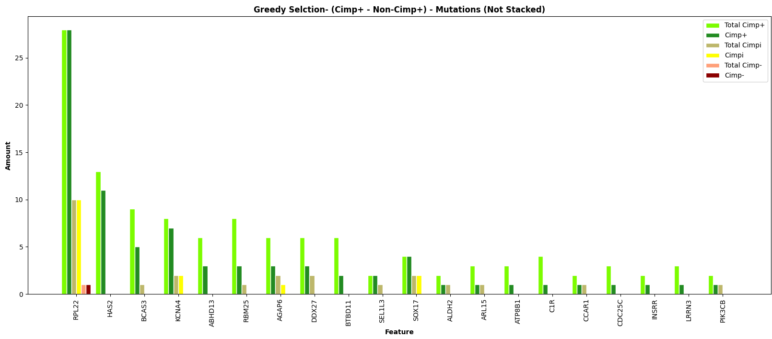
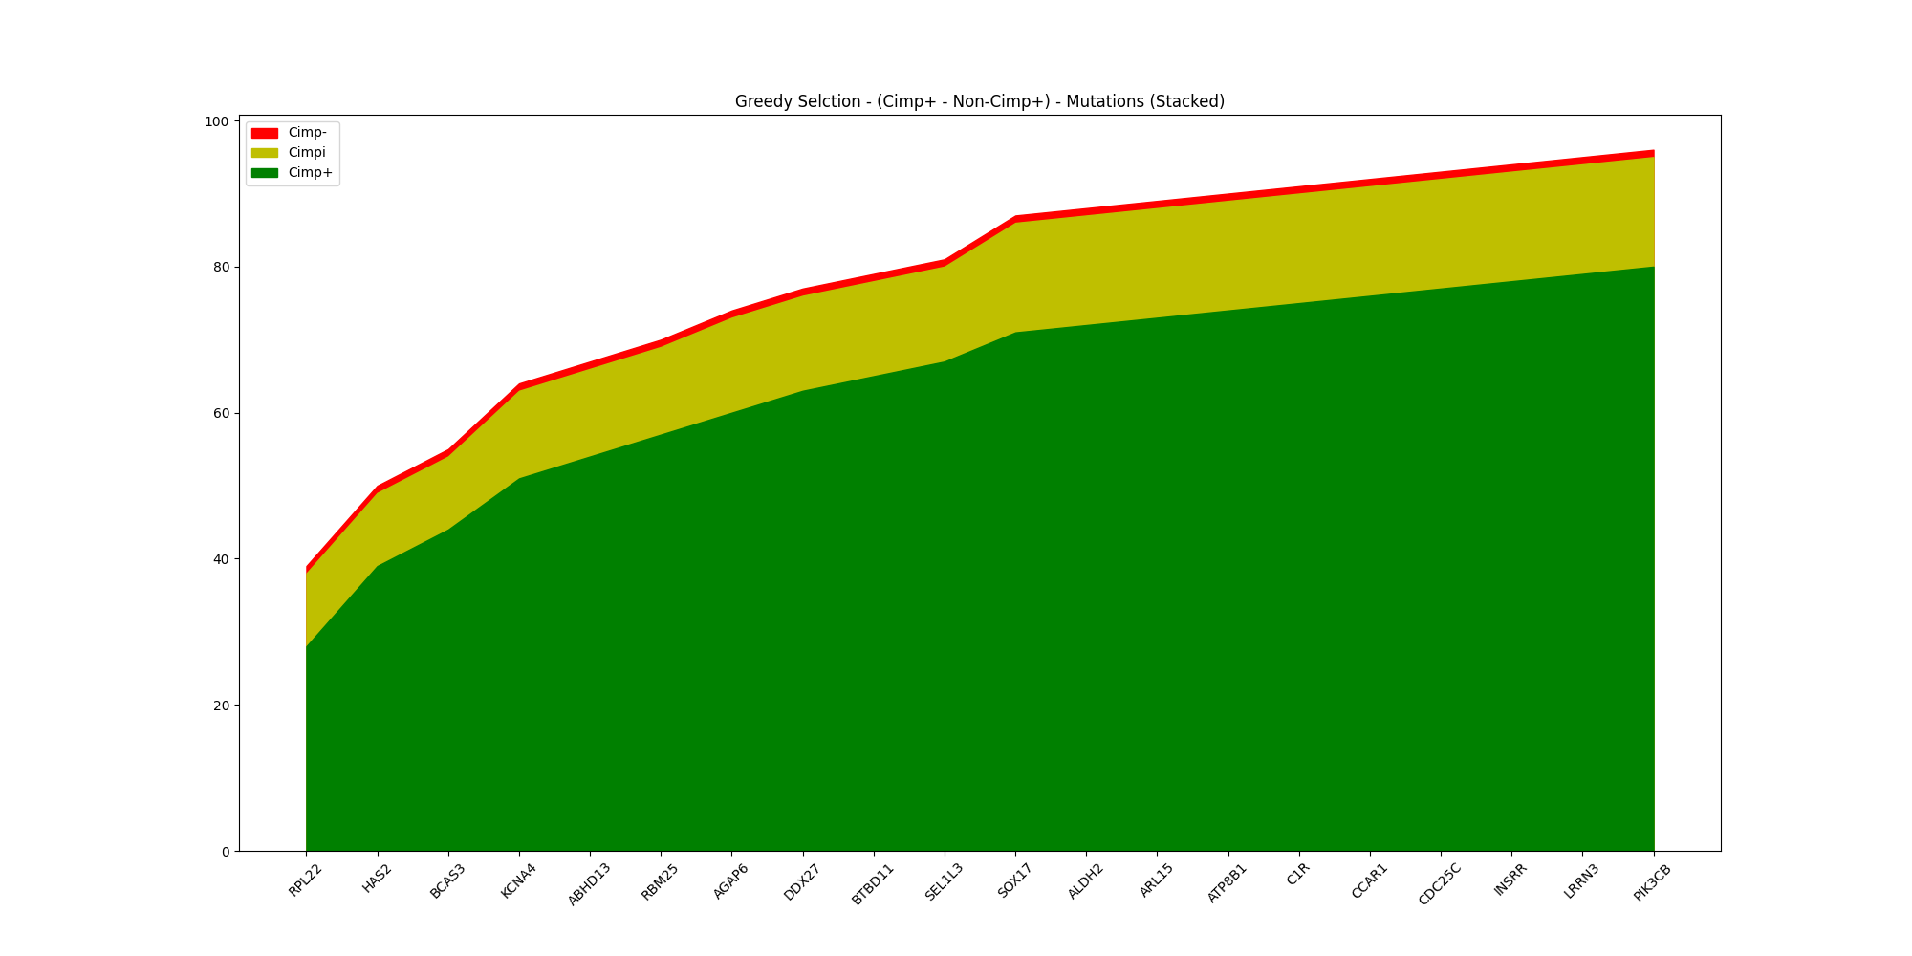
Select by Cimp+ - Non-Cimp+

Slide 30
Name | Cimp+ | Non-Cimp+
RPL22 | 28 | 11
HAS2 | 11 | 0
BCAS3 | 5 | 0
KCNA4 | 7 | 2
ABHD13 | 3 | 0
RBM25 | 3 | 0
AGAP6 | 3 | 1
DDX27 | 3 | 0
BTBD11 | 2 | 0
SEL1L3 | 2 | 0
SOX17 | 4 | 2
ALDH2 | 1 | 0
ARL15 | 1 | 0
C1R | 1 | 0
Name | Cimp+ | Non-Cimp+
CCAR1 | 1 | 0
CDC25C | 1 | 0
INSRR | 1 | 0
LRRN3 | 1 | 0
PIK3CB | 1 | 0
Metric | Value
TP | 80
FP | 16
FN | 28
TN | 255
Accuracy | 0.884
Sensitivity | 0.741
Specificity | 0.941
Precision | 0.833
Miss Rate | 0.259
False Discovery Rate | 0.167
False Omission Rate | 0.099

Slide 31
Select by Cimp+ - 2Non-Cimp+

Slide 32
Name | Cimp+ | Non-Cimp+
API5 | 15 | 1
HAS2 | 10 | 0
MMP16 | 6 | 0
ABHD13 | 4 | 0
AFF1 | 6 | 1
CASP7 | 4 | 0
ADNP2 | 3 | 0
ABCC4 | 2 | 0
BMP2 | 2 | 0
C6 | 2 | 0
CDC25C | 2 | 0
COL11A1 | 2 | 0
DNAJC7 | 2 | 0
GRIK4 | 2 | 0
Name | Cimp+ | Non-Cimp+
KCNH7 | 2 | 0
ATP8B1 | 1 | 0
B4GALNT4 | 1 | 0
BCL3 | 1 | 0
BLZF1 | 1 | 0
C1R | 1 | 0
CHRM4 | 1 | 0
FAM186A | 1 | 0
GPR39 | 1 | 0
INSRR | 1 | 0
LRRN3 | 1 | 0
OR7C1 | 1 | 0
PSMA8 | 1 | 0
SLCO5A1 | 1 | 0
Metric | Value
TP | 77
FP | 2
FN | 31
TN | 269
Accuracy | 0.927
Sensitivity | 0.706
Specificity | 0.992
Precision | 0.963
Miss Rate | 0.294
False Discovery Rate | 0.037
False Omission Rate | 0.08

Slide 33
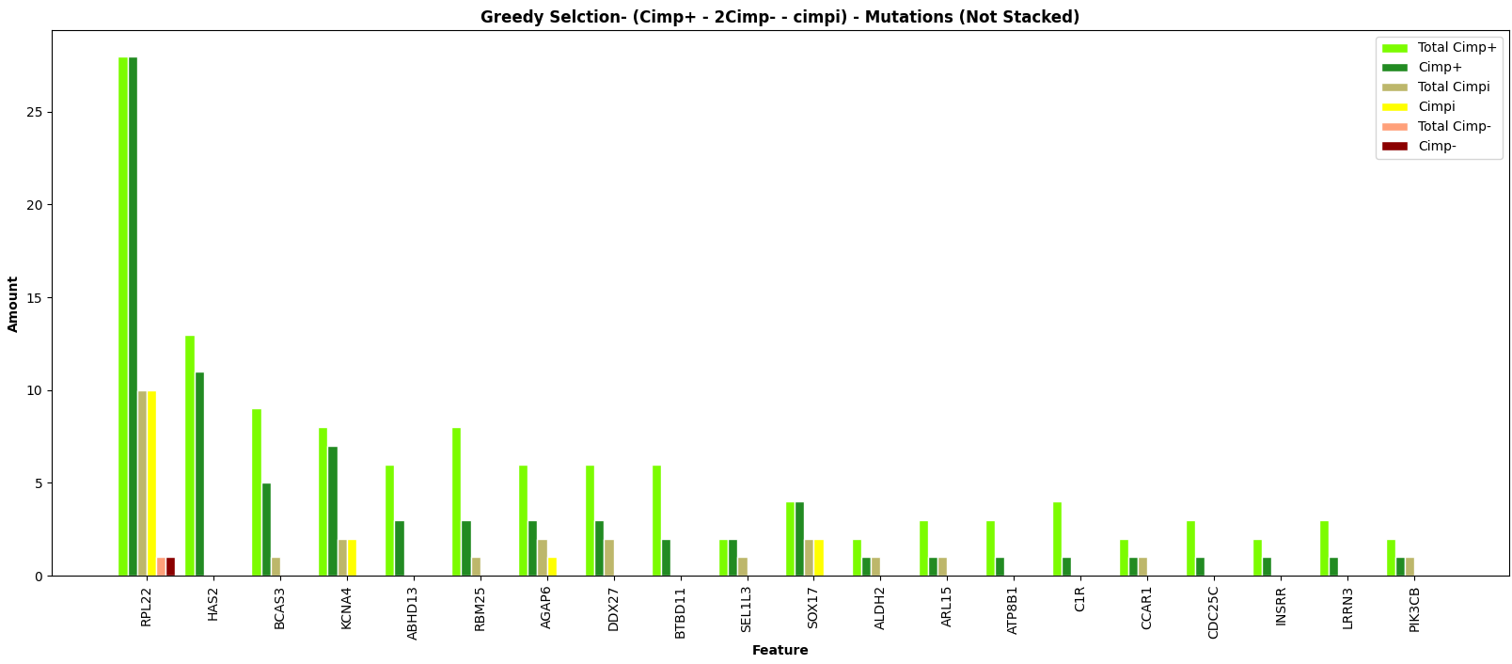

Select by Cimp+ - 2Cimp- - Cimpi

Slide 34
Name | Cimp+ | Non-Cimp+
RPL22 | 28 | 11
HAS2 | 11 | 0
BCAS3 | 5 | 0
KCNA4 | 7 | 2
ABHD13 | 3 | 0
RBM25 | 3 | 0
AGAP6 | 3 | 1
DDX27 | 3 | 0
BTBD11 | 2 | 0
SEL1L3 | 2 | 0
SOX17 | 4 | 2
ALDH2 | 1 | 0
ARL15 | 1 | 0
ATP8B1 | 1 | 0
Name | Cimp+ | Non-Cimp+
C1R | 1 | 0
CCAR1 | 1 | 0
CDC25C | 1 | 0
INSRR | 1 | 0
LRRN3 | 1 | 0
PIC3CB | 1 | 0
Metric | Value
TP | 80
FP | 16
FN | 28
TN | 255
Accuracy | 0.857
Sensitivity | 0.222
Specificity | 0.941
Precision | 0.333
Miss Rate | 0.778
False Discovery Rate | 0.667
False Omission Rate | 0.099

Slide 35
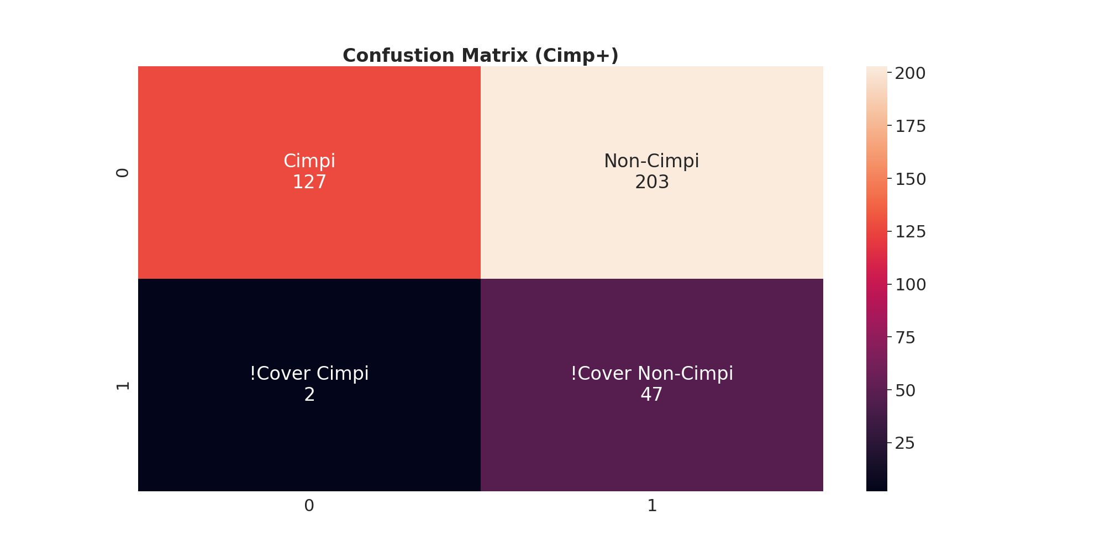
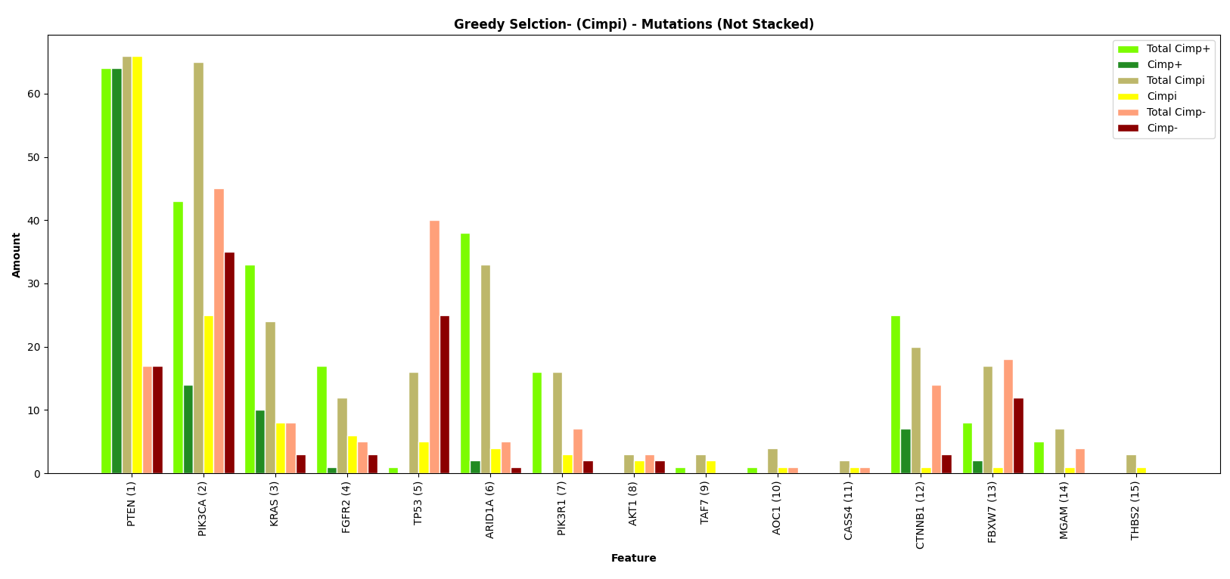
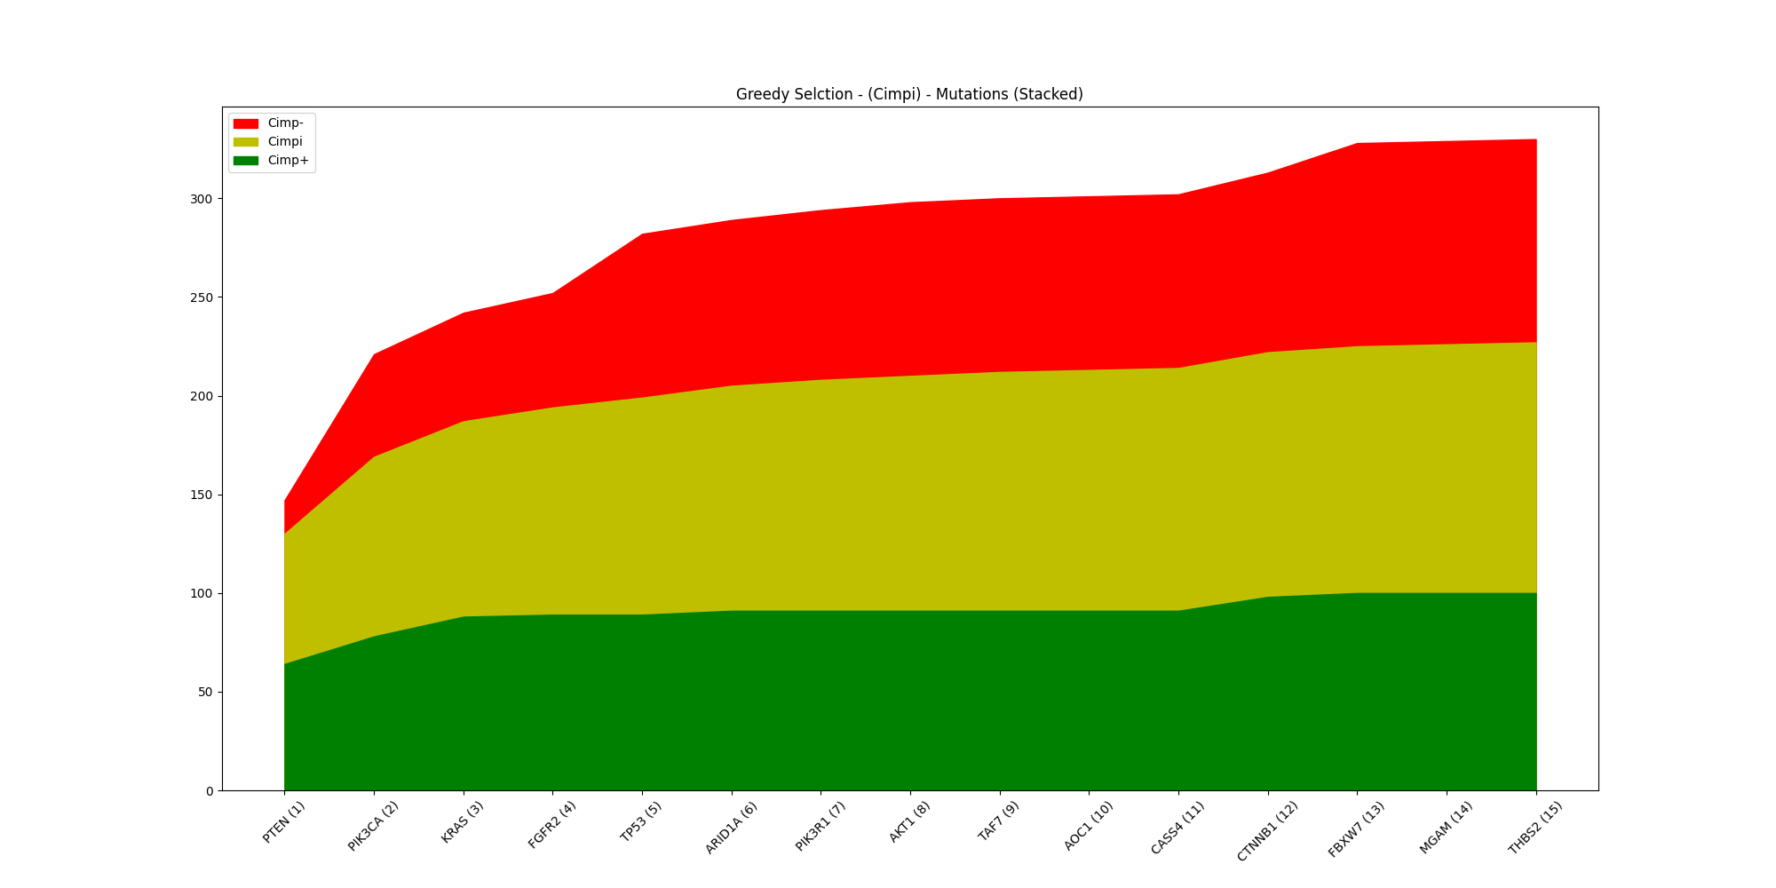
Select by Cimpi

Slide 36
Name | Cimpi | Non-Cimpi
PTEN | 66 | 81
PIK3CA | 25 | 49
KRAS | 8 | 13
FRGFR2 | 6 | 4
TP53 | 5 | 25
ARID1A | 4 | 3
PIK3R1 | 3 | 2
AKT1 | 2 | 2
TAF7 | 2 | 0
AOC1 | 1 | 0
CASS4 | 1 | 0
CTNNB1 | 1 | 10
FBXW7 | 1 | 14
MGAM | 1 | 0
Name | Cimpi | Non-Cimpi
THBS2 | 1 | 0
Metric | Value
TP | 127
FP | 203
FN | 2
TN | 47
Accuracy | 0.459
Sensitivity | 0.984
Specificity | 0.188
Precision | 0.385
Miss Rate | 0.016
False Discovery Rate | 0.615
False Omission Rate | 0.041

Slide 37

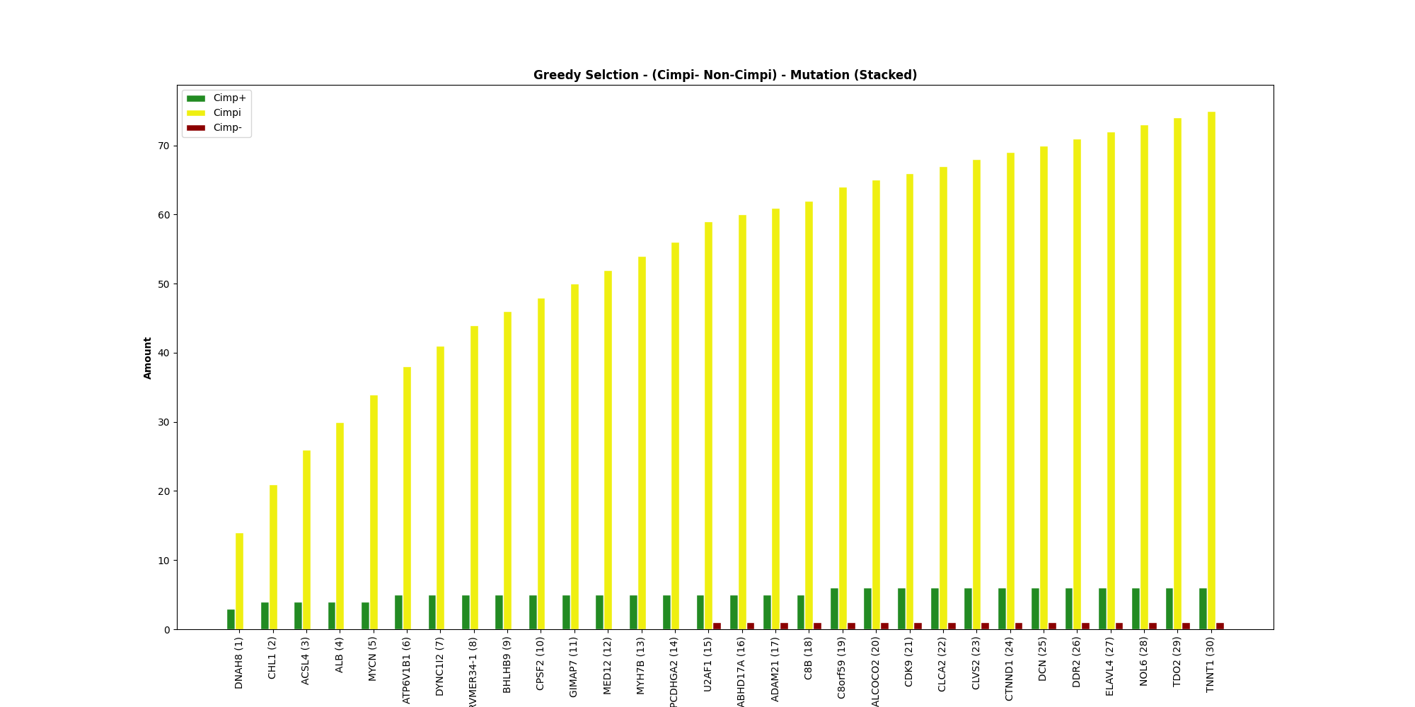
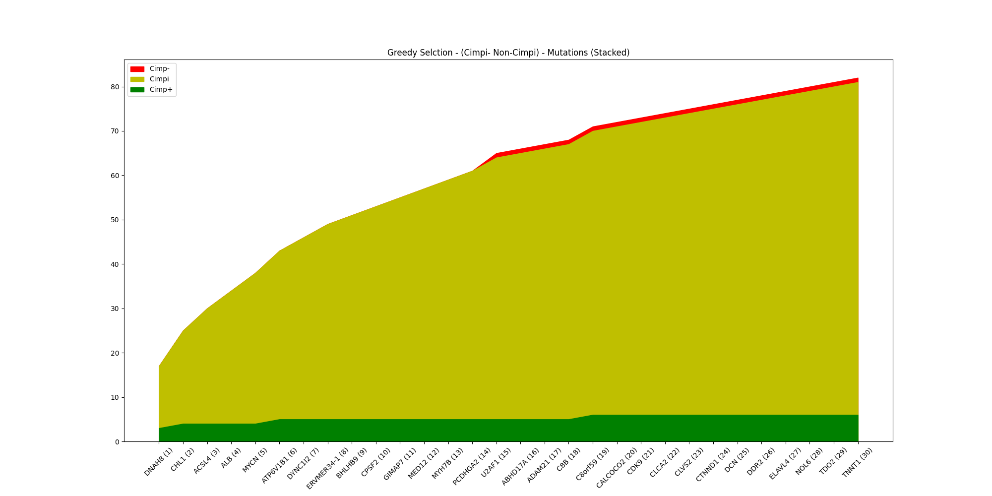
Select by Cimpi – Non-Cimpi

Slide 38
Name | Cimpi | Non-Cimpi
DNAH8 | 14 | 3
CHL1 | 7 | 1
ACSL4 | 5 | 0
ALB | 4 | 0
MYCN | 4 | 0
ATP6V1B1 | 4 | 1
DYNC1I2 | 3 | 0
ERVMER34 | 3 | 0
BHLHB9 | 2 | 0
CPSF2 | 2 | 0
GIMAP7 | 2 | 0
MED12 | 2 | 0
MYH7B | 2 | 0
PCDHGA2 | 2 | 0
Name | Cimpi | Non-Cimpi
U2AF1 | 3 | 1
ABHD17A | 1 | 0
ADAM21 | 1 | 0
C8B | 1 | 0
C8orf59 | 2 | 1
CALCOCO2 | 1 | 0
CDK9 | 1 | 0
CLCA2 | 1 | 0
CLVS2 | 1 | 0
CTNND1 | 1 | 0
DCN | 1 | 0
DDR2 | 1 | 0
ELAVL4 | 1 | 0
(3) | 3 | 0
Metric | Value
TP | 75
FP | 7
FN | 54
TN | 243
Accuracy | 0.839
Sensitivity | 0.581
Specificity | 0.972
Precision | 0.915
Miss Rate | 0.419
False Discovery Rate | 0.085
False Omission Rate | 0.182

Slide 39
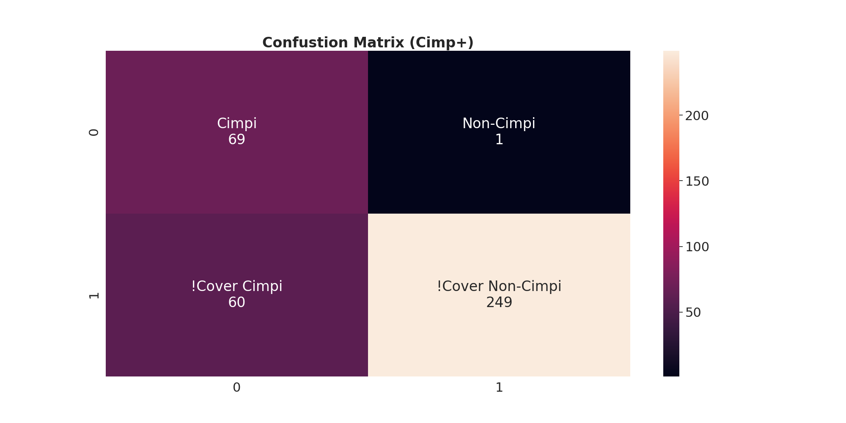
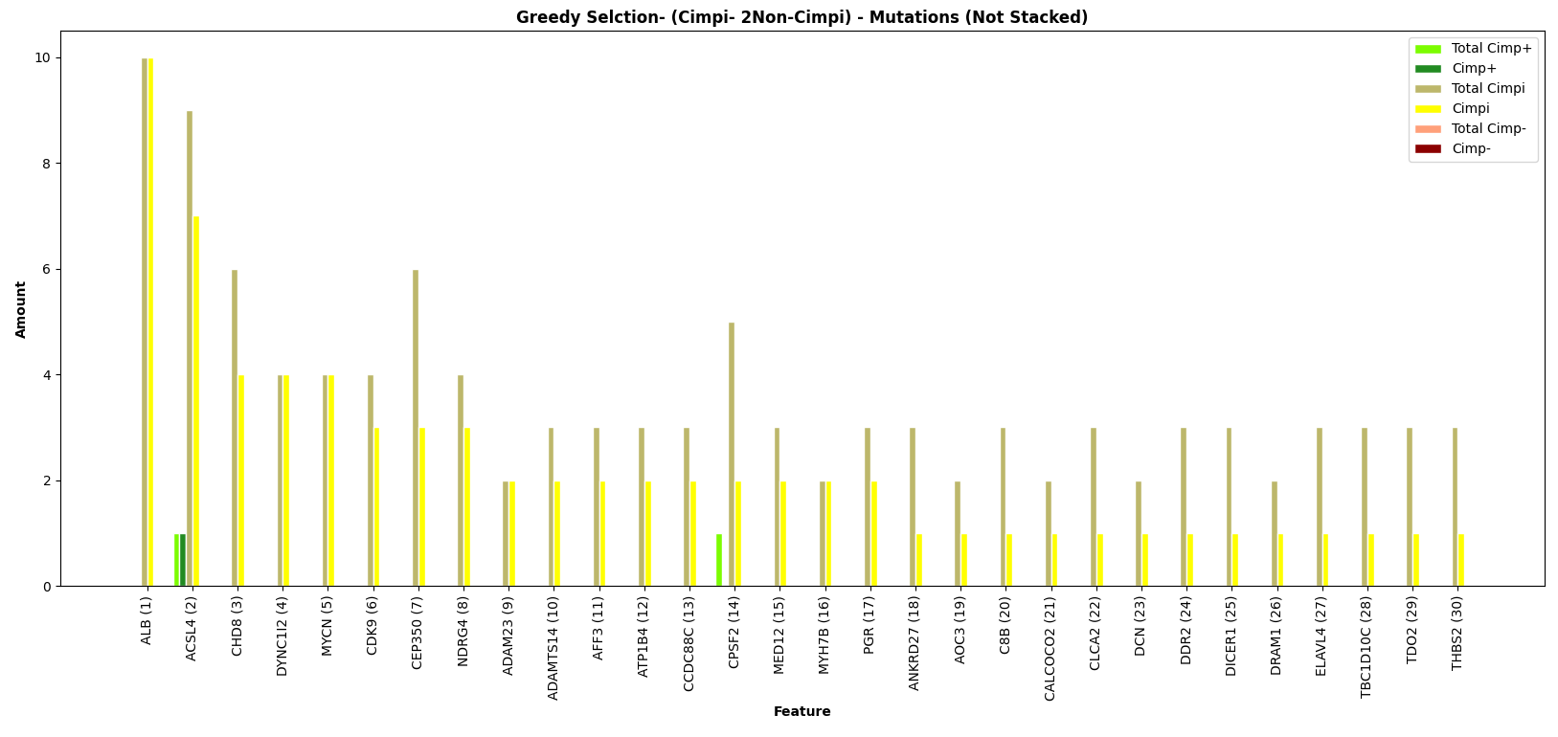
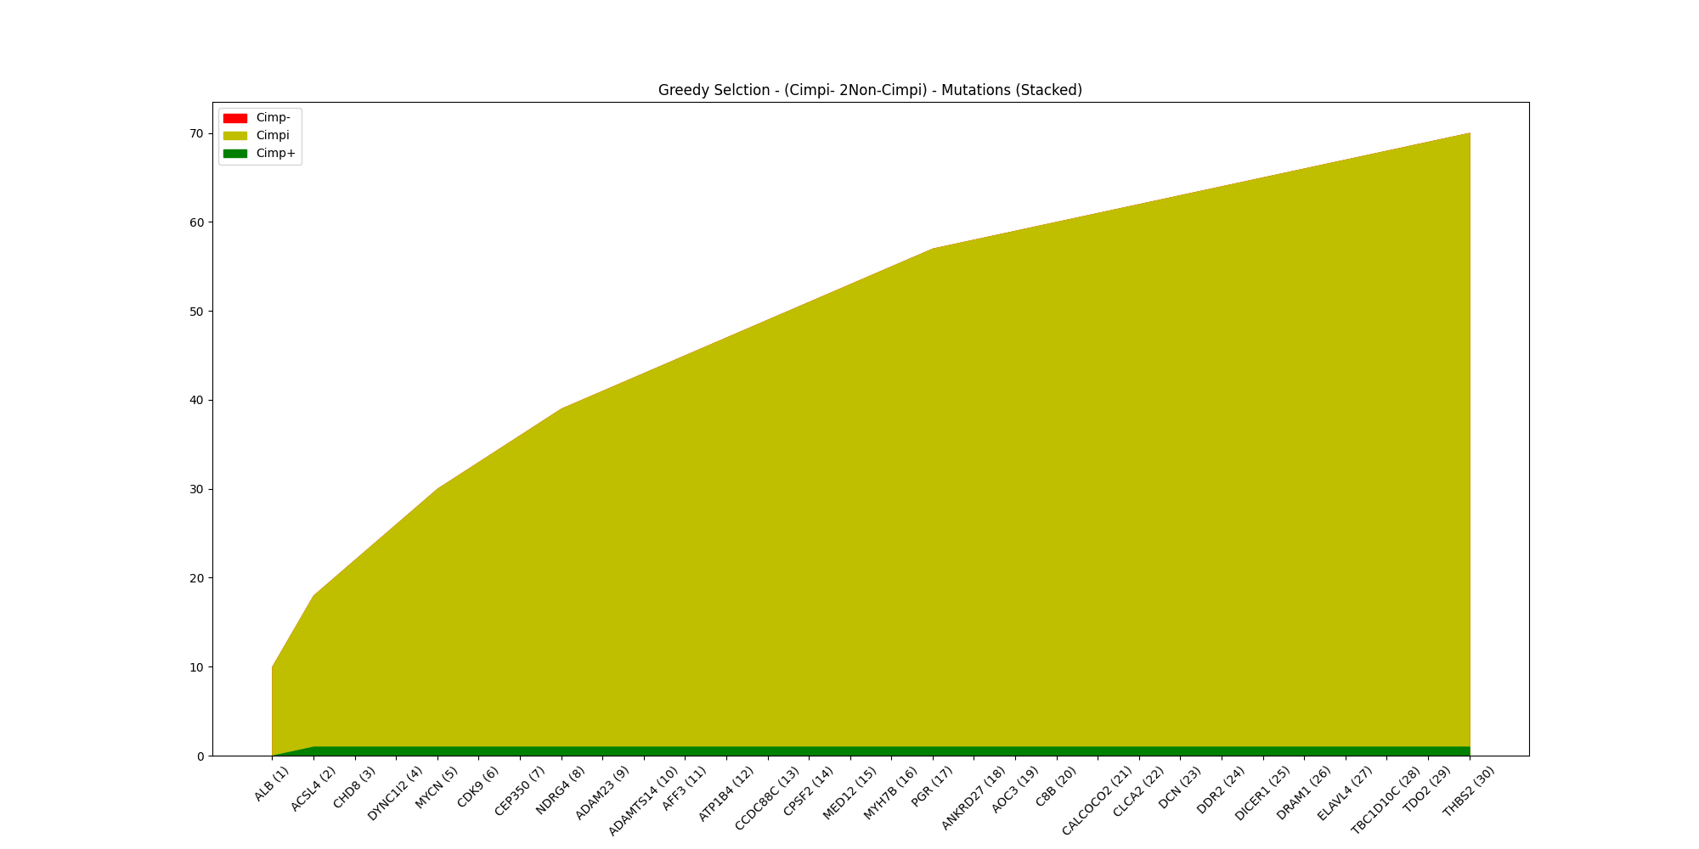
Select by Cimpi – 2Non-Cimpi

Slide 40
Name | Cimpi | Non-Cimpi
ALB | 10 | 0
ACSL4 | 7 | 1
CHD8 | 4 | 0
DYNC1I2 | 4 | 0
MYCN | 4 | 0
CDK9 | 3 | 0
CEP350 | 3 | 0
NDRG4 | 3 | 0
ADAM23 | 2 | 0
ADAMTS14 | 2 | 0
AFF3 | 2 | 0
ATP1B4 | 2 | 0
CCDC88C | 2 | 0
CPSF2 | 2 | 0
Name | Cimpi | Non-Cimpi
MED12 | 2 | 0
MYH7B | 2 | 0
PGR | 2 | 0
ANKRD27 | 1 | 0
AOC3 | 1 | 0
C8B | 1 | 0
CALCOCO2 | 1 | 0
CLCA2 | 1 | 0
DCN | 1 | 0
DDR2 | 1 | 0
DDR2 | 1 | 0
DICER1 | 1 | 0
DRAM1 | 1 | 0
(4) | 4 | 0
Metric | Value
TP | 69
FP | 1
FN | 60
TN | 249
Accuracy | 0.839
Sensitivity | 0.535
Specificity | 0.996
Precision | 0.986
Miss Rate | 0.465
False Discovery Rate | 0.014
False Omission Rate | 0.194

